Slide 1

GHAR SEWA
1
Major Project Mid - Term Defense
Team Members:
Kismat Bahadur Chhetri
Prashant Bastola
Shandip Thapa
Supervisor: Er.Krishna Khadka

Slide 2
INTRODUCTION:
2
“Gharsewa” is an mobile app that can provide the facilities from any place to find a suitable living area according to their choice.
Everyone can search for their desired option from anywhere through location, type and city.

Slide 3
OBJECTIVES:
2
General Objective:
To develop a centralized platform that connects house owner with potential tenants.
Specific Objective: •
To improve a rental experience of both house owners and tenants by providinga facility such as property listings,searching,booking,and communication.
To integrate an AI-based room recommendation system into the application that utilizes user location data, preferences, and historical choices to provide personalized and relevant suggestions for available rental rooms

Slide 4
LITERATURE REVIEW
2
Applications | Map Integration | ICT Deployment | AI Recommendation
Smart House Renting | YES | YES | NO
Boarding House Finder | NO | NO | NO
Rental House Management System | NO | NO | NO
Bachelor House Rental Management System | NO | NO | NO
Ghar Sewa | YES | YES | YES

Slide 5
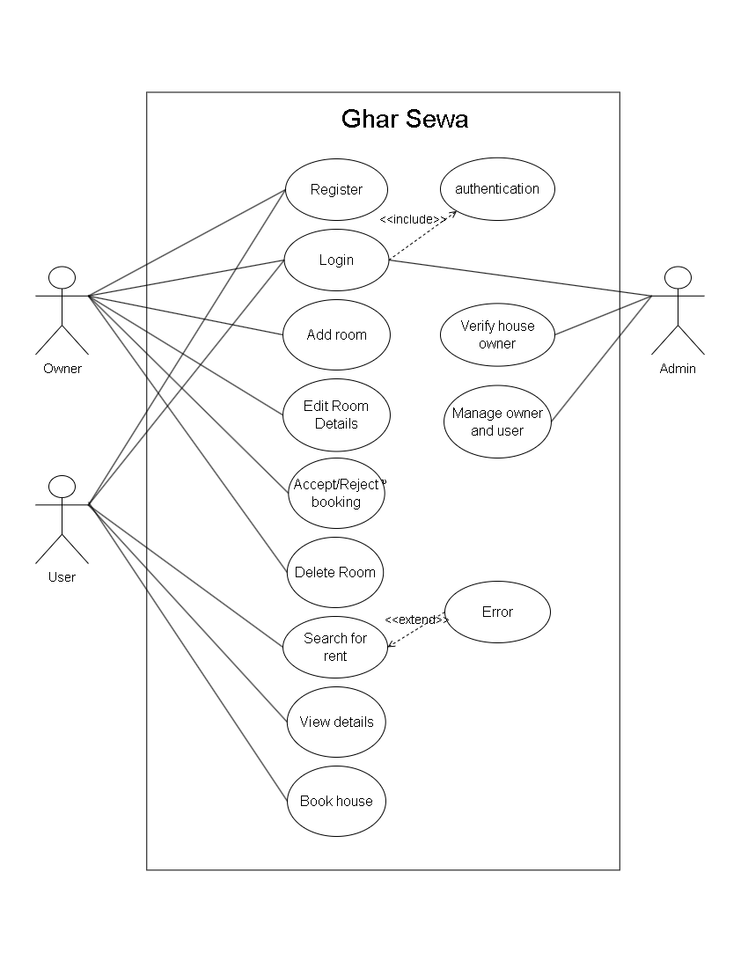
USE CASE DIAGRAM
9

Slide 6
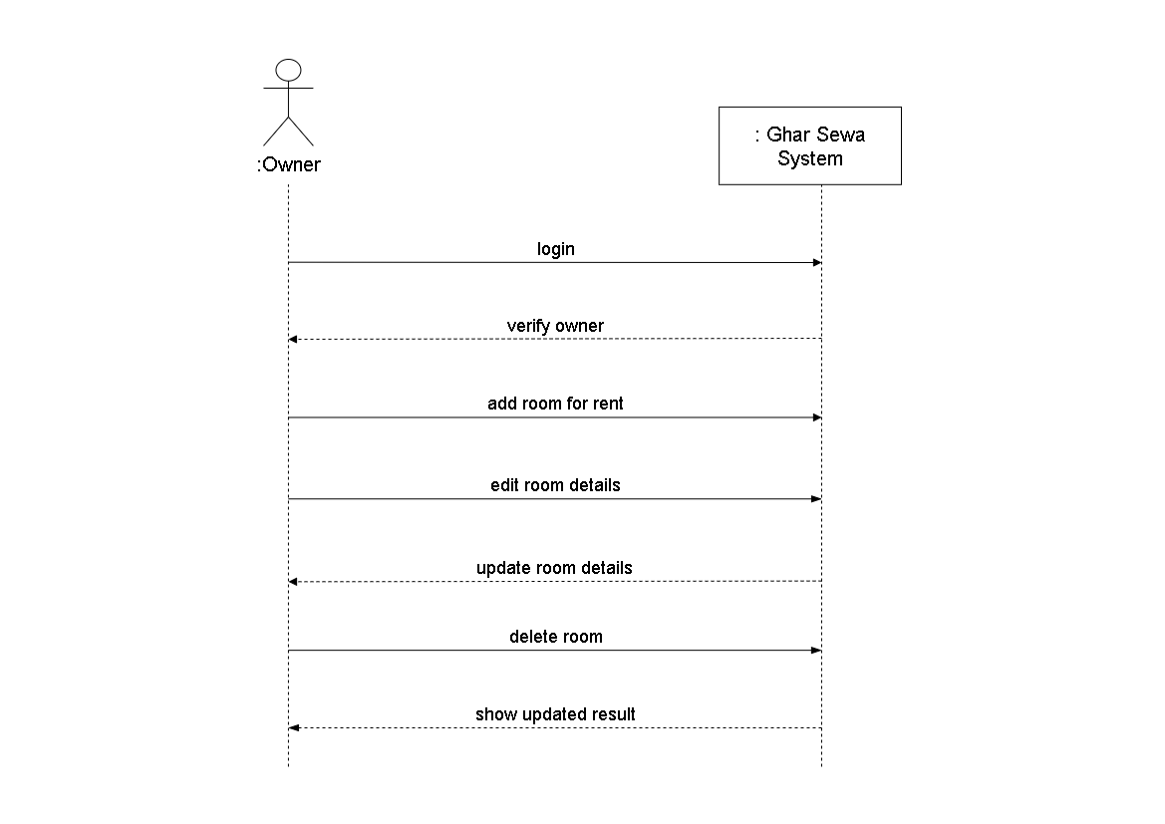
SYSTEM SEQUENCE DIAGRAM
9

Slide 7
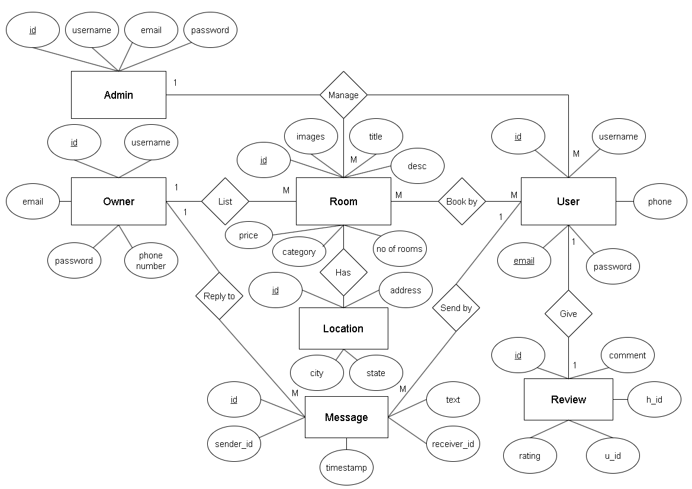
ER DIAGRAM
9

Slide 8
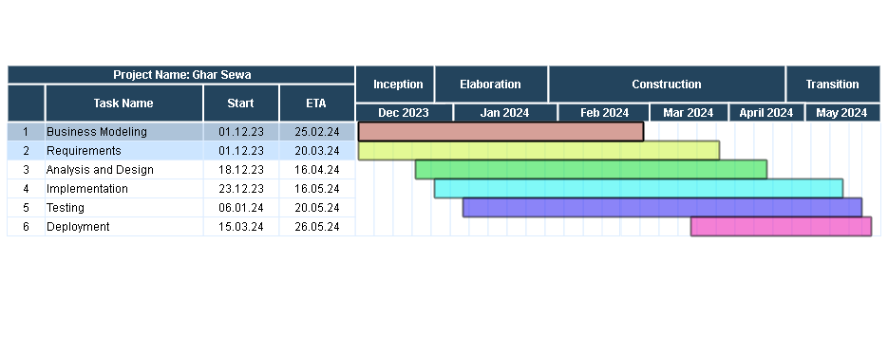
GANTT CHART
9

Slide 9

THANK YOU! Any Queries??

